Slide 1
ROAD LANE DETECTION
MADE BY : VIDIT SINGH
ALLOCATED PROJECT : ROAD LANE DETECTION

Slide 2
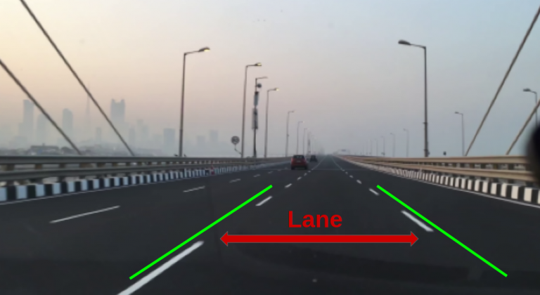
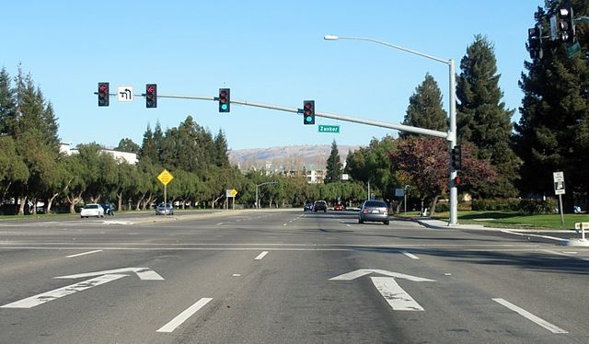
Problem statement
“A lane is part of a roadway (carriageway) that is designated to be used by a single line of vehicles, to control and guide drivers and reduce traffic conflicts.”
Lane detection is a critical component of self-driving cars and autonomous vehicles. Once lane positions are obtained, the vehicle will know where to go and avoid the risk of running into other lanes or getting off the road.
The Lane Detection System project addresses the challenge of developing a computer vision solution to accurately identify and track road lanes in real-time, essential for enhancing the safety and precision of autonomous vehicles and driver assistance systems.

Slide 3

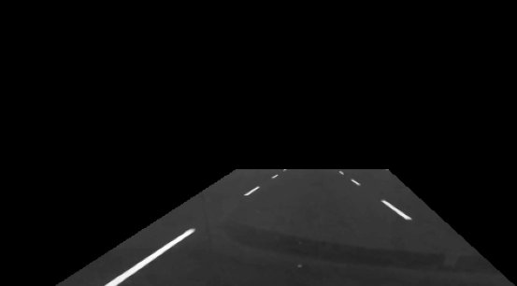
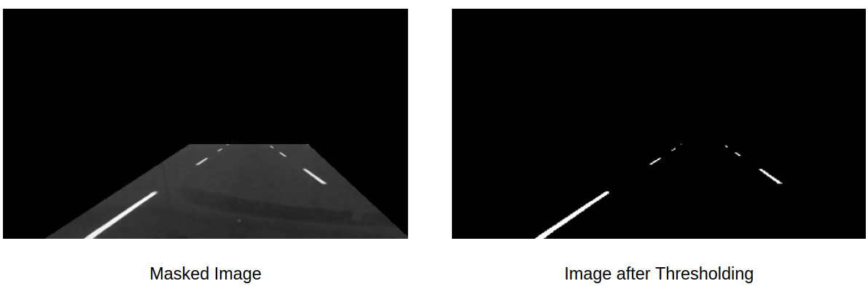
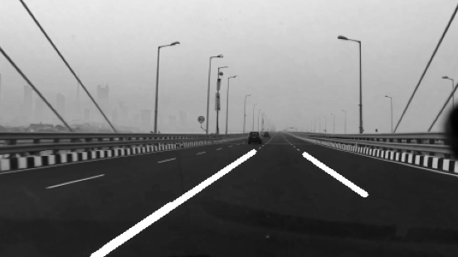
STEPS FOR Lane detection
UPLOADING FRAMES
FRAME MASKING
IMAGE THRESHOLDING
HOUGH LINE TRANSFORMATION

Slide 4

Thank You!

Slide 5

Network Technology
Problem Solving
Algorithm
Automation

